Slide 1
FACE EMOTION DETECTION
Using python and deep face
PRESENTED BY :
K. S. Noor mohammad

Slide 2
Introduction to Face Emotion Detection
Face Emotion Detection is an Artificial Intelligence–based technology that identifies human emotions by analyzing facial expressions. It uses computer vision and machine learning techniques to detect emotions such as happiness, sadness, anger, fear, surprise, and neutrality from facial images or video streams.
This system first detects a human face, extracts important facial features like eyes, eyebrows, mouth movements, and then classifies the emotion using trained models such as deep neural networks. Face Emotion Detection plays a vital role in improving human–computer interaction by enabling machines to understand human feelings.

Slide 3
✅ Technologies Used
Python
OpenCV
Machine Learning
Deep Learning (CNN)
TensorFlow / Keras

Slide 4
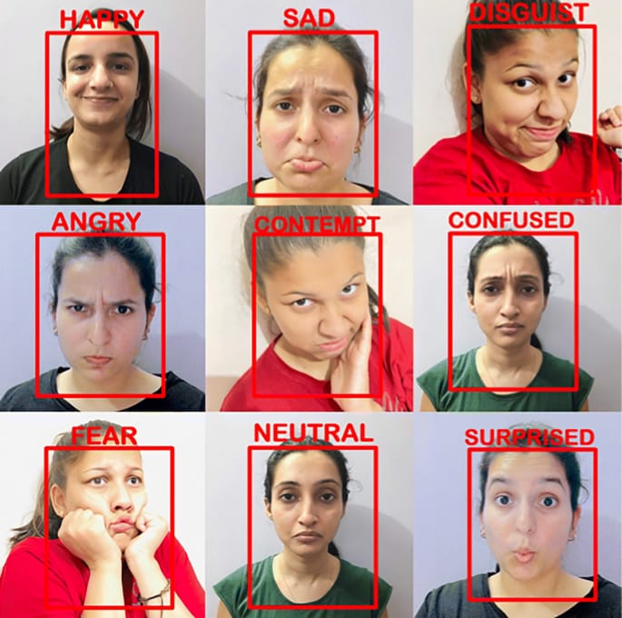
Face detection ---|---

Slide 5
🔹 Important Points of Face Emotion Detection
Key Emotions Detected
Happy
Sad
Angry
Fear
Surprise
Neutral
Disgust

Slide 6
🔹 Face Emotion Detection – Working
Face Emotion Detection is a project that detects human emotions from facial expressions using a camera or image.
It mainly uses Python libraries for detection and prediction, and HTML to display results on a web page.

Slide 7
STEP BY STEP PROCES :
Step 1: Capture Face Image
A webcam or image is used to capture a person’s face.
Python uses OpenCV to access the camera and read video frames.
Python Library Used:
opencv-python
Step 2: Face Detection
The captured image is converted to grayscale.
A face detection algorithm (Haar Cascade or CNN) detects the face region.

Slide 8
Step 3: Feature Extraction :
Facial features like eyes, mouth, eyebrows are extracted.
These features represent expressions such as smiling or frowning.
Emotion Classification
The detected face is passed to a trained machine learning / deep learning model.
The model predicts emotions such as:
  Happy
  Sad
  Angry
  Surprise
  Neutral

Slide 9
STEP : 4
Display Emotion Output
The predicted emotion is displayed:
  On the image frame (Python)
  Or on a web page using HTML

Slide 10
THANK YOU

